Slide 1
A Predictive Model for the 2016 Presidential Election
Sujoy GAYEN
Springboard: Foundations of Data Science Workshop

Slide 2
Background
Results of 2016 presidential election surprising
Appears that Trump won unusually high number of white working class vote in key states that have often voted Democratic in prior elections
Leading to an electoral college victory despite a popular vote loss
Goal of this project to develop a predictive model for vote share for each of the 2 major parties that could potentially be used in future presidential elections

Slide 3
The Dataset
https://github.com/Deleetdk/USA.county.data
A good portion of this data came from the New York Time’s 2016 presidential election county-by-county-analysis.
The overall dataset includes 13 attributes for 3145 observations.
The observations come from each county in the United States.

Slide 4
Dataset Variables
Fips: 4 digit county identification number
Name of the county
Average age of the inhabitants of the county: variable name is average_age
Percentage of the population of the county that is white: percent_white
Percentage of the population that lacks health insurance: percent_uninsured
Percentage of the population that has an educational degree: percent_degree
Average income of the inhabitants of the county: average_income
State that the county is located in
Percentage of the population of the county that voted for Republican candidate Donald Trump in 2016 presidential election: percent_republican
Percentage of the population of the county that voted for Democrat candidate Hillary Clinton in 2016 presidential election: percent_democrat
Percentage of the population of the county that voted for Republican candidate Mitt Romney in 2012 presidential election: percent_republican_2012
Percentage of the population of the county that voted for Democrat candidate Barack Obama in 2012 presidential election: percent_democrat_2012

Slide 5
Data Wrangling
32 observations with missing values for the variables of county name and the percentage share of the Republican and Democratic vote share in both the 2012 and 2016 presidential elections
29 of these 32 missing observations are in the state of Alaska, which does not release county data for its presidential elections.
Decision was made to not include these 32 missing observations in our analysis.

Slide 6
Correlation between percent_republican and explanatory variables
#average_age 0.3325677
#percent_republican_2012 0.9347904
#percent_white 0.5365550
#percent_uninsured 0.1950089
#percent_degree -0.4936432
#percent_unemployed -0.2728920
#average_income -0.1996266

Slide 7
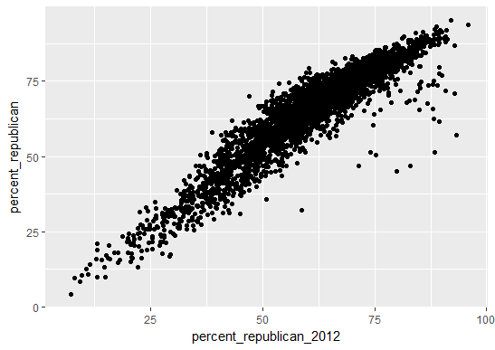
Percent_republican vs. percent_republican_2012

Slide 8
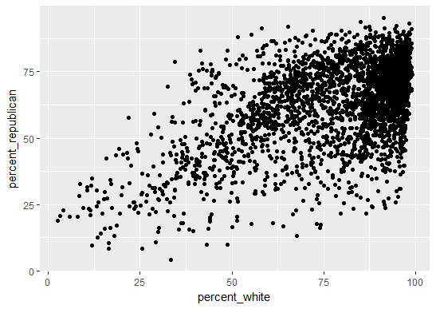
Percent_republican vs. percent_white

Slide 9
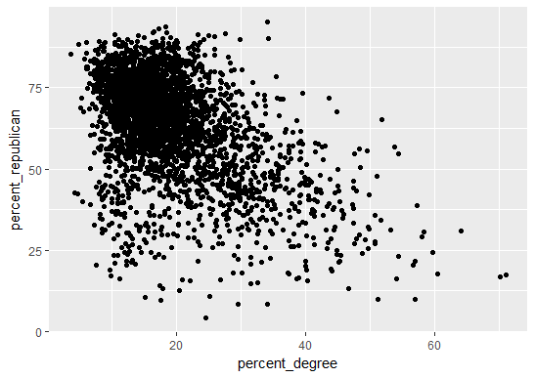
Percent_republican vs percent_degree

Slide 10
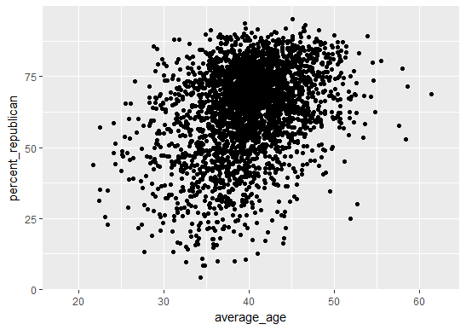
Percent_republican vs average_age

Slide 11
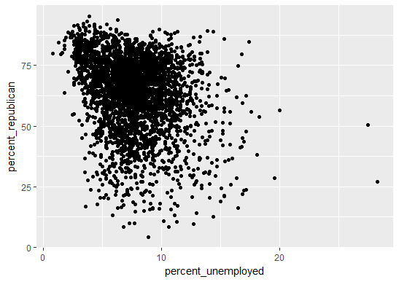
Percent_republican vs percent_unemployed

Slide 12
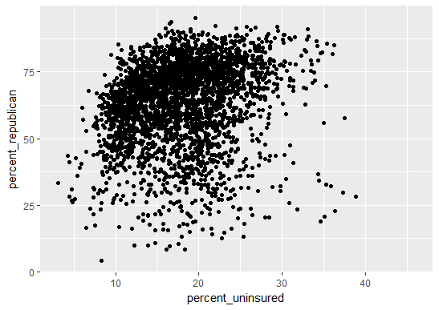
Percent_republican vs percent_uninsured

Slide 13
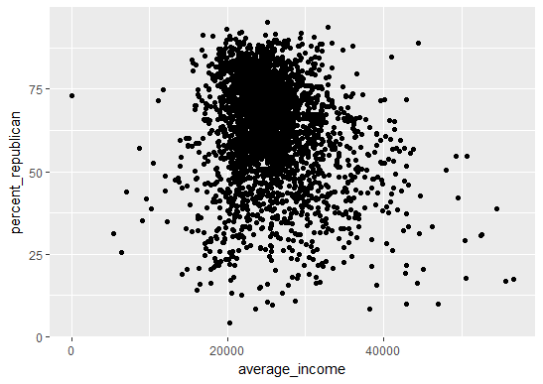
Percent_republican vs. average_income

Slide 14
Initial Linear Regression Model
Divided data set into test set (80%) and training set (20%)
Initial model contained all 7 explanatory variables
Average_income had wrong sign (model had positive coefficient, but in actuality correlation coefficient between
Average_income and percent_republican is negative)
This is due to collinearity
Since average_income poorly correlated anyway, average_income removed from model

Slide 15
Linear Regression Model 2
All explanatory variables except average_income
percent_uninsured not significant in this odel
Since percent_uninsured has high degree of collinearity with percent_white and has poor correlation with percent_republican, percent_uninsured removed from model

Slide 16
Final Regression Model
5 explanatory variables (average_income and percent_uninsured removed)
The explanatory variables in the final model are average_age, percent_republican_2012, percent_degree, percent_unemployed, and percent_white
All five variables significant with correct sign
R2 has remained high at 0.9587 (unchanged from initial model)
SSE and RMSE negligibly increased from initial model

Slide 17
Making Predictions on the Test Set using our training set model
I took this final model and used it on the test data set to create a new variable in the test data set, predict_republican.
This variable consisted of all the predicted values of the 2016 presidential election Republican percentage vote share using this model that was built using the training set.
The correlation coefficient between the predicted 2016 presidential election Republican percentage vote share(predict_republican) and the actual percentage(percent_republican) in the test dataset was 0.974.
R-squared value was 0.974^2=0.949.
The high R and R-squared values indicate that this final predictive model is a good fit for the test data.

Slide 18
Interpretations and Conclusions
Variables that are positively correlated with percent_republican: percent_republican 2012, percent_white, and average_age
Variables that are negatively correlated with percent_republican: percent_degree, percent_unemployed
With regards to overall voter turnout strategy, Republican political operatives should focus on counties where a larger percentage of the population is elderly, white, lacking an educational degree, and employed.
On the other hand, Democrats should be focusing on counties where a larger percentage of the population is young, non-white, college-educated or higher, and unemployed.

Slide 19
Thank You!!

